Slide 1
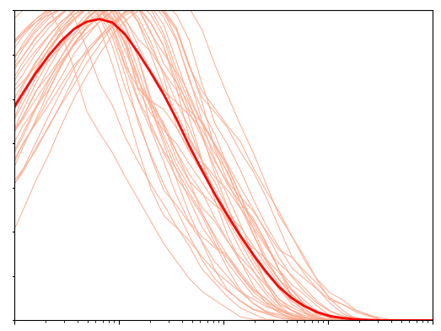
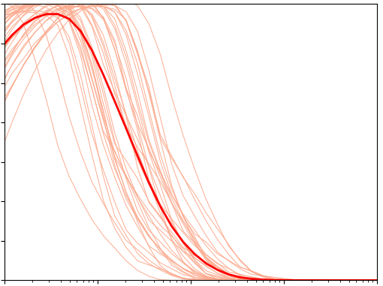
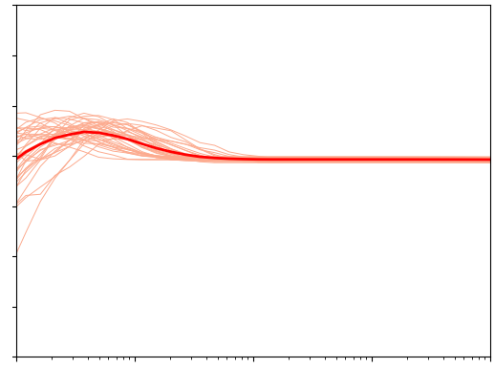
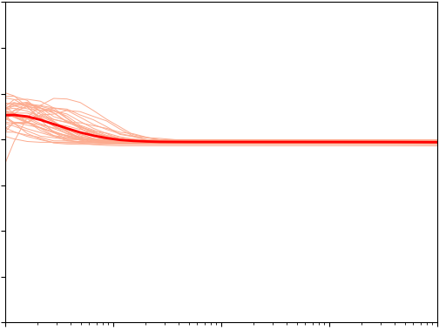
Calculate for each individual receptor, over 10,000 signals s, of given complexity k.
k = 6
k = 12
7
0
MI of individual receptors
Bits
Non-adaptive
Average MI
10⁰ 10⁴
7
0
Adaptive
Bits
10⁰ 10⁴
Odor intensity

Slide 2
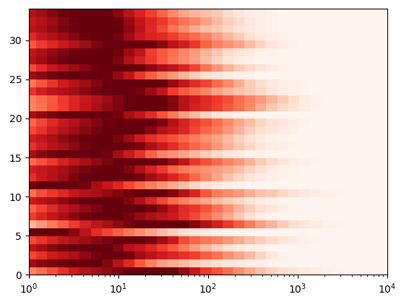

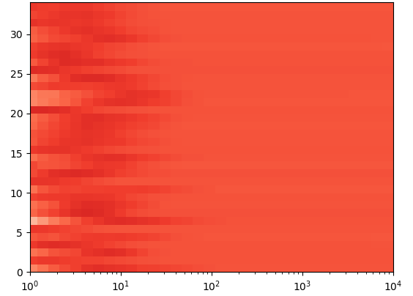
Sum over 10,000 signals s of given sparsity and mean intensity.
Bits
Non-adaptive
Receptor
10⁰ 10⁴
Adaptive
Receptor
10⁰ 10⁴
Odor intensity

